Slide 1

AIE1901 S07 Large Language Models for Social Simulations
Lecture 1: Introduction to AI and Social Simulation
Instructor: Zhanzhan Zhao
School of Artificial Intelligence
School of Humanities and Social Science
School of Data Science (by courtesy)
CUHK, Shenzhen
Teaching Assistant: Xiao Jia

Slide 2
Outline
Introduction to Artificial Intelligence (AI)
Introduction to AI for Social Science
Introduction to Social Simulations
Introduction to LLM-driven Social Simulations
Course Logistics

Slide 3
What is Artificial Intelligence (AI)?
Notes:
来源：https://www.tableau.com/data-insights/ai/what-is
What is Artificial Intelligence?
The original definition of AI, defined in 1955 by John McCarthy, one of the original creators of the field, was pretty broad and all-encompassing: “The science and engineering of making intelligent machines.”
A slightly more modern definition of AI is: a broad branch of computer science concerned with creating machines that can learn, make decisions, and perform tasks to a human-like level. Advanced AI machines can learn and grow on their own, independent of human intervention. Even basic AI can handle complex tasks that would normally need a human touch but may need the help of a programmer to learn from its mistakes and improve.

Slide 4
What is Artificial Intelligence (AI)?
Original Definition (McCarthy, 1955):
“The science and engineering of making intelligent machines.”
🤖Modern View:
AI is a branch of computer science that builds machines capable of:
thinking and acting rationally like human.
Notes:
来源：https://www.tableau.com/data-insights/ai/what-is
What is Artificial Intelligence?
The original definition of AI, defined in 1955 by John McCarthy, one of the original creators of the field, was pretty broad and all-encompassing: “The science and engineering of making intelligent machines.”
A slightly more modern definition of AI is: a broad branch of computer science concerned with creating machines that can learn, make decisions, and perform tasks to a human-like level. Advanced AI machines can learn and grow on their own, independent of human intervention. Even basic AI can handle complex tasks that would normally need a human touch but may need the help of a programmer to learn from its mistakes and improve.

Slide 5
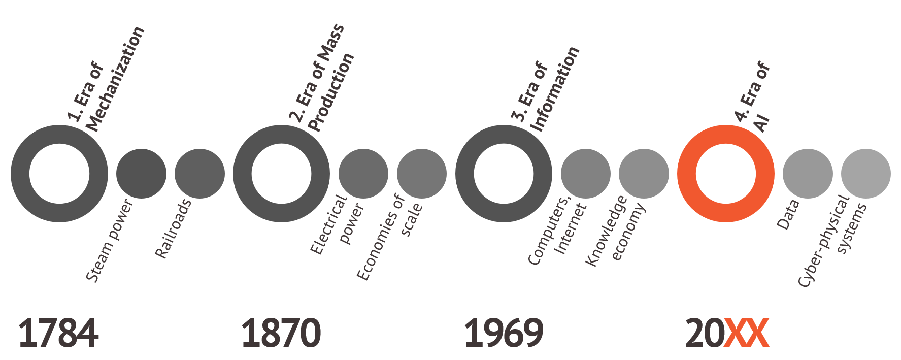
Notes:
来源：https://openethics.ai/how-the-era-of-artificial-intelligence-will-transform-society/

Slide 6
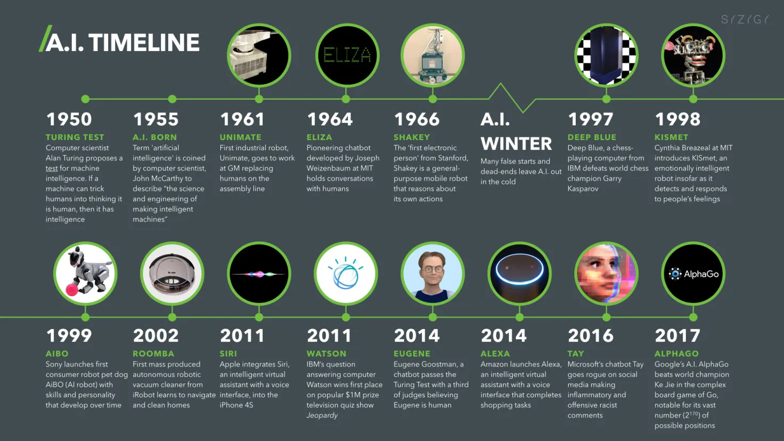
Brief History of AI:
https://digitalwellbeing.org/artificial-intelligence-timeline-infographic-from-eliza-to-tay-and-beyond/
Notes:
https://digitalwellbeing.org/artificial-intelligence-timeline-infographic-from-eliza-to-tay-and-beyond/
1950-1979: The first programming language for AI was created. Basic AI programs that could answer questions or sort data were made. The first example of an autonomous vehicle was created.
1980-1987: The first breakthrough in AI research led to increased funding, which led to more breakthroughs. Conferences on AI were held for the first time, and commercial AI came onto the market.
1987-1993: Private and public investors halted their investments, convinced AI was a fad and wouldn’t go anywhere. AI researchers continued to work regardless, just with fewer resources.
1993-2011: The first AI system beat a human world champion at chess. The first Roomba hit the market in 2002. Nasa landed rovers on Mars, and the first digital assistant (Siri) was released by Apple in 2011.
2012–present: A major milestone came in 2012 with the ImageNet Large Scale Visual Recognition Challenge (ILSVRC), where AlexNet reduced top-5 error rates by a large margin, sparking the deep learning revolution in image recognition. This breakthrough demonstrated the power of convolutional neural networks (CNNs) trained on large datasets, influencing advances in speech, NLP, and multimodal AI. In 2022, ChatGPT ignited a global surge of interest in large language models (LLMs).
最后向学生提问：What does the future hold?

Slide 7
AI Classifications:
AI
ANI
(artificial narrow intelligence)
E.g., Siri (Apple’s voice assistant) self-driving car, recommender systems used in TikTok
Generative AI
(generative artificial intelligence)
E.g., ChatGPT, DeepSeek,
Midjourney, DALL-E
AGI
(artificial general intelligence)
Do anything a human
can do
Notes:
https://www.coursera.org/learn/ai-for-everyone/lecture/SRwLN/week-1-introduction
如今，我们从人工智能中看到的很大一部分价值 是人工狭义智能（ANI）。 这些人工智能只能做一件事， 例如智能扬声器或自动驾驶汽车。 或者用于网络搜索的人工智能， 或农业或工厂中的人工智能应用程序。 这些类型的人工智能只是一窍不通， 但是当你找到合适的技巧时， 这可能会非常有价值。 随着生成式人工智能的兴起， 诸如聊天GPT之类的东西。 我们也开始看到人工智能， 它更具通用性。 例如，Chat GPT 可以是文案编辑、 头脑风暴伙伴、文本摘要生成器，还可以 提供许多其他帮助。 这些模型是一项令人兴奋的发展，正在 进一步扩展我们现在可以用人工智能做的事情。 此外，人工智能还指AGI 或人工通用智能的概念。 这是构建人工智能的目标，它可以完成 人类所能完成的任何智力任务， 甚至可能变得超级 聪明，做比任何人类都能做更多的事情。 我看到 ANI、 人工狭义智能 以及生成式人工智能方面取得了长足的进步。 感觉人工智能研究 正在缓慢地 朝着人工智能迈出微小的一步，这令人兴奋。 但实际上，我们离 人工智能或人工通用智能还有很长的路要走。 不幸的是，ANI和Genitive AI的快速发展 非常 有价值，这使人们得出结论， 人工智能已经取得了很多进展，这确实是事实。 但这反过来又导致人们 错误地认为我们 也可能处于AGI的边缘。 这导致了人们对 邪恶有感觉的机器人即将接管人类的过分和不必要的担忧。 我认为 AGI 是研究人员努力实现的令人兴奋的目标， 但要实现这一目标， 还需要多项技术突破。

Slide 8
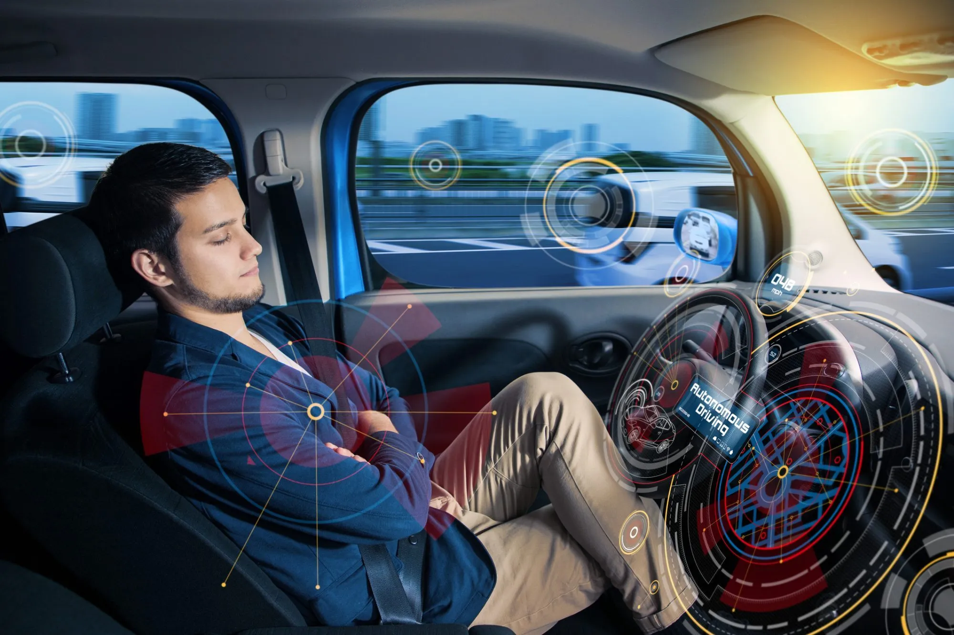
ANI : an AI system designed and trained to perform a specific task very well, but without general reasoning ability beyond that task.
E.g. Self-driving car
https://calmatters.org/projects/self-driving-cars-california-climate-goals-carbon-free/
Notes:
https://calmatters.org/projects/self-driving-cars-california-climate-goals-carbon-free/
如今，我们从人工智能中看到的很大一部分价值 是人工狭义智能（ANI）。 这些人工智能只能做一件事， 例如智能扬声器或自动驾驶汽车。 或者用于网络搜索的人工智能， 或农业或工厂中的人工智能应用程序。 这些类型的人工智能只是一窍不通， 但是当你找到合适的技巧时， 这可能会非常有价值。 随着生成式人工智能的兴起， 诸如聊天GPT之类的东西。 我们也开始看到人工智能， 它更具通用性。 例如，Chat GPT 可以是文案编辑、 头脑风暴伙伴、文本摘要生成器，还可以 提供许多其他帮助。 这些模型是一项令人兴奋的发展，正在 进一步扩展我们现在可以用人工智能做的事情。 此外，人工智能还指AGI 或人工通用智能的概念。 这是构建人工智能的目标，它可以完成 人类所能完成的任何智力任务， 甚至可能变得超级 聪明，做比任何人类都能做更多的事情。 我看到 ANI、 人工狭义智能 以及生成式人工智能方面取得了长足的进步。 感觉人工智能研究 正在缓慢地 朝着人工智能迈出微小的一步，这令人兴奋。 但实际上，我们离 人工智能或人工通用智能还有很长的路要走。 不幸的是，ANI和Genitive AI的快速发展 非常 有价值，这使人们得出结论， 人工智能已经取得了很多进展，这确实是事实。 但这反过来又导致人们 错误地认为我们 也可能处于AGI的边缘。 这导致了人们对 邪恶有感觉的机器人即将接管人类的过分和不必要的担忧。 我认为 AGI 是研究人员努力实现的令人兴奋的目标， 但要实现这一目标， 还需要多项技术突破。

Slide 9
AI Classifications:
AI
ANI
(artificial narrow intelligence)
E.g., Siri (Apple’s voice assistant) self-driving car, recommender systems used in TikTok
Generative AI
(generative artificial intelligence)
E.g., ChatGPT, DeepSeek,
Midjourney, DALL-E
AGI
(artificial general intelligence)
Do anything a human
can do
Notes:
https://www.coursera.org/learn/ai-for-everyone/lecture/SRwLN/week-1-introduction
如今，我们从人工智能中看到的很大一部分价值 是人工狭义智能（ANI）。 这些人工智能只能做一件事， 例如智能扬声器或自动驾驶汽车。 或者用于网络搜索的人工智能， 或农业或工厂中的人工智能应用程序。 这些类型的人工智能只是一窍不通， 但是当你找到合适的技巧时， 这可能会非常有价值。 随着生成式人工智能的兴起， 诸如聊天GPT之类的东西。 我们也开始看到人工智能， 它更具通用性。 例如，Chat GPT 可以是文案编辑、 头脑风暴伙伴、文本摘要生成器，还可以 提供许多其他帮助。 这些模型是一项令人兴奋的发展，正在 进一步扩展我们现在可以用人工智能做的事情。 此外，人工智能还指AGI 或人工通用智能的概念。 这是构建人工智能的目标，它可以完成 人类所能完成的任何智力任务， 甚至可能变得超级 聪明，做比任何人类都能做更多的事情。 我看到 ANI、 人工狭义智能 以及生成式人工智能方面取得了长足的进步。 感觉人工智能研究 正在缓慢地 朝着人工智能迈出微小的一步，这令人兴奋。 但实际上，我们离 人工智能或人工通用智能还有很长的路要走。 不幸的是，ANI和Genitive AI的快速发展 非常 有价值，这使人们得出结论， 人工智能已经取得了很多进展，这确实是事实。 但这反过来又导致人们 错误地认为我们 也可能处于AGI的边缘。 这导致了人们对 邪恶有感觉的机器人即将接管人类的过分和不必要的担忧。 我认为 AGI 是研究人员努力实现的令人兴奋的目标， 但要实现这一目标， 还需要多项技术突破。

Slide 10

Generative AI: an AI system focuses on creating new content (text, images, audio, video, code, etc) that did not exist before.
Notes:
https://www.coursera.org/learn/ai-for-everyone/lecture/SRwLN/week-1-introduction
如今，我们从人工智能中看到的很大一部分价值 是人工狭义智能（ANI）。 这些人工智能只能做一件事， 例如智能扬声器或自动驾驶汽车。 或者用于网络搜索的人工智能， 或农业或工厂中的人工智能应用程序。 这些类型的人工智能只是一窍不通， 但是当你找到合适的技巧时， 这可能会非常有价值。 随着生成式人工智能的兴起， 诸如聊天GPT之类的东西。 我们也开始看到人工智能， 它更具通用性。 例如，Chat GPT 可以是文案编辑、 头脑风暴伙伴、文本摘要生成器，还可以 提供许多其他帮助。 这些模型是一项令人兴奋的发展，正在 进一步扩展我们现在可以用人工智能做的事情。 此外，人工智能还指AGI 或人工通用智能的概念。 这是构建人工智能的目标，它可以完成 人类所能完成的任何智力任务， 甚至可能变得超级 聪明，做比任何人类都能做更多的事情。 我看到 ANI、 人工狭义智能 以及生成式人工智能方面取得了长足的进步。 感觉人工智能研究 正在缓慢地 朝着人工智能迈出微小的一步，这令人兴奋。 但实际上，我们离 人工智能或人工通用智能还有很长的路要走。 不幸的是，ANI和Genitive AI的快速发展 非常 有价值，这使人们得出结论， 人工智能已经取得了很多进展，这确实是事实。 但这反过来又导致人们 错误地认为我们 也可能处于AGI的边缘。 这导致了人们对 邪恶有感觉的机器人即将接管人类的过分和不必要的担忧。 我认为 AGI 是研究人员努力实现的令人兴奋的目标， 但要实现这一目标， 还需要多项技术突破。

Slide 11
AI Classifications:
AI
ANI
(artificial narrow intelligence)
E.g., Siri (Apple’s voice assistant) self-driving car, recommender systems used in TikTok
Generative AI
(generative artificial intelligence)
E.g., ChatGPT, DeepSeek,
Midjourney, DALL-E
AGI
(artificial general intelligence)
Do anything a human
can do
Notes:
https://www.coursera.org/learn/ai-for-everyone/lecture/SRwLN/week-1-introduction
如今，我们从人工智能中看到的很大一部分价值 是人工狭义智能（ANI）。 这些人工智能只能做一件事， 例如智能扬声器或自动驾驶汽车。 或者用于网络搜索的人工智能， 或农业或工厂中的人工智能应用程序。 这些类型的人工智能只是一窍不通， 但是当你找到合适的技巧时， 这可能会非常有价值。 随着生成式人工智能的兴起， 诸如聊天GPT之类的东西。 我们也开始看到人工智能， 它更具通用性。 例如，Chat GPT 可以是文案编辑、 头脑风暴伙伴、文本摘要生成器，还可以 提供许多其他帮助。 这些模型是一项令人兴奋的发展，正在 进一步扩展我们现在可以用人工智能做的事情。 此外，人工智能还指AGI 或人工通用智能的概念。 这是构建人工智能的目标，它可以完成 人类所能完成的任何智力任务， 甚至可能变得超级 聪明，做比任何人类都能做更多的事情。 我看到 ANI、 人工狭义智能 以及生成式人工智能方面取得了长足的进步。 感觉人工智能研究 正在缓慢地 朝着人工智能迈出微小的一步，这令人兴奋。 但实际上，我们离 人工智能或人工通用智能还有很长的路要走。 不幸的是，ANI和Genitive AI的快速发展 非常 有价值，这使人们得出结论， 人工智能已经取得了很多进展，这确实是事实。 但这反过来又导致人们 错误地认为我们 也可能处于AGI的边缘。 这导致了人们对 邪恶有感觉的机器人即将接管人类的过分和不必要的担忧。 我认为 AGI 是研究人员努力实现的令人兴奋的目标， 但要实现这一目标， 还需要多项技术突破。

Slide 12
How large language models (LLMs) work？
LLMs are built by using supervised learning (A→B) to repeatedly predict the next word.
My favorite animal is a dog
Input (A) | Output (B)
My favorite | animal
My favorite animal | is
My favorite animal is | a
My favorite animal is a | dog
When we train a very large AI system on a lot of data (hundreds of billions of words), we get a Large Language Model like ChatGPT.
Notes:
来源：https://www.coursera.org/learn/ai-for-everyone/lecture/SRwLN/week-1-introduction

Slide 13
What is AI for Social Science?
Notes:
来源：https://www.tableau.com/data-insights/ai/what-is
What is Artificial Intelligence?
The original definition of AI, defined in 1955 by John McCarthy, one of the original creators of the field, was pretty broad and all-encompassing: “The science and engineering of making intelligent machines.”
A slightly more modern definition of AI is: a broad branch of computer science concerned with creating machines that can learn, make decisions, and perform tasks to a human-like level. Advanced AI machines can learn and grow on their own, independent of human intervention. Even basic AI can handle complex tasks that would normally need a human touch but may need the help of a programmer to learn from its mistakes and improve.

Slide 14

What is Social Science?
Notes:
来源：https://www.tableau.com/data-insights/ai/what-is
What is Artificial Intelligence?
The original definition of AI, defined in 1955 by John McCarthy, one of the original creators of the field, was pretty broad and all-encompassing: “The science and engineering of making intelligent machines.”
A slightly more modern definition of AI is: a broad branch of computer science concerned with creating machines that can learn, make decisions, and perform tasks to a human-like level. Advanced AI machines can learn and grow on their own, independent of human intervention. Even basic AI can handle complex tasks that would normally need a human touch but may need the help of a programmer to learn from its mistakes and improve.

Slide 15
AI for Social Science Examples
Social phenomena & opinion analysis: Analyzing global social media discourse using sentiment analysis and topic modeling to track polarization and misinformation trends.
Simulating social dilemmas: Modeling interactions in Tragedy of the Commons scenarios where agents negotiate resource usage and test intervention strategies.
Cultural dynamics modeling: Using LLMs as agents with distinct cultural norms to study cross-cultural negotiation, cooperation, and conflict resolution patterns.

Slide 16


AI for Social Science Examples
Opinion Mining: Analyzing global social media discourse using AI to track public opinion, emotion, and attitudes’ trends.

Slide 17
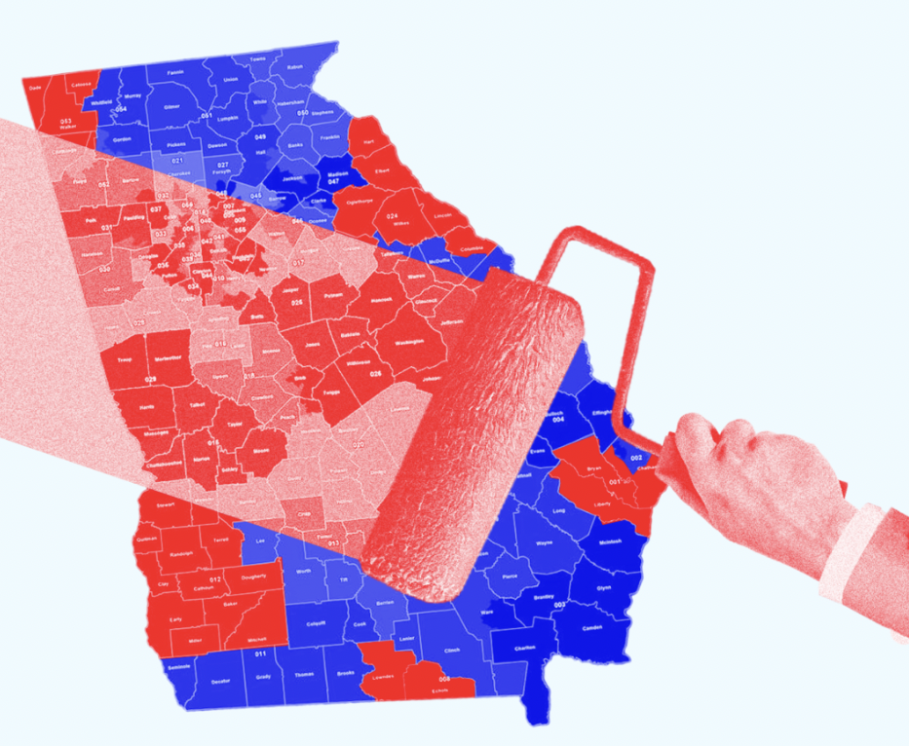
AI for Social Science Examples
AI for Fair Public Policy Making: the use of AI tools to design, evaluate, and implement public policies that are more equitable, transparent, and data-driven.

Slide 18
What is a Social Simulation?
Notes:
来源：https://www.tableau.com/data-insights/ai/what-is
What is Artificial Intelligence?
The original definition of AI, defined in 1955 by John McCarthy, one of the original creators of the field, was pretty broad and all-encompassing: “The science and engineering of making intelligent machines.”
A slightly more modern definition of AI is: a broad branch of computer science concerned with creating machines that can learn, make decisions, and perform tasks to a human-like level. Advanced AI machines can learn and grow on their own, independent of human intervention. Even basic AI can handle complex tasks that would normally need a human touch but may need the help of a programmer to learn from its mistakes and improve.

Slide 19





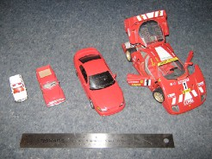

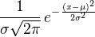


What is a Model?
Reality
Abstraction of Reality
Physical
e.g. miniature, animal model
Diagram
e.g. schematic, cartoon
Mathematical
e.g. equations, code
DNA
F = ma
TF
Protein
RNA

Slide 20
Models are abstractions
•
They are simplifications—and so they are wrong!
•
But they are also often useful
•
Abstraction is both their strength & weakness
•
The trick is, how much to simplify? What details to keep, which ones to remove?
•
Even “simple” systems can be complex

Slide 21
Why build models?
•
You already are! If you imagine or project how a situation might unfold you are already using a (mental) model
•
So really, the question is, why build explicit
models?

Slide 22
Why build models?
•
Understand mechanisms, causality
•
Help to guide & test treatment, intervention strategies, test alternative scenarios (counterfactuals)
•
Forecast/predict

Slide 23
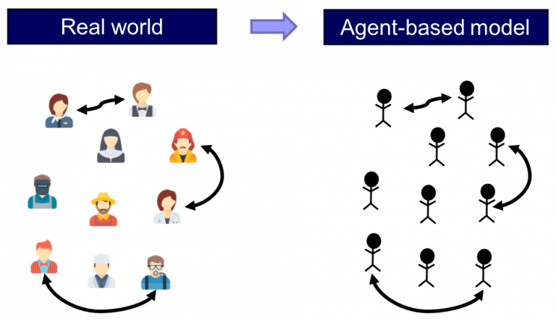
What is an Agent-Based Model (ABM) / Social Simulation?
An agent is an autonomous individual element with properties and actions in a computer simulation.
Agent-Based Modeling (ABM) is the idea that the world can be modeled using agents, an environment, and a description of agent-agent and agent environment interactions.
Notes:
https://www.complexityexplorer.org/courses/214-introduction-to-agent-based-modeling/segments/20837#gsc.tab=0
Santa Fe Institute
An Introduction to Agent-Based Modeling
Unit 1: What is ABM and Why Should You Use It?

Slide 24


Social Simulation Pipeline
Model
system structure, assumptions, causal processes, mechanisms
Parameters,
initial conditions, other inputs
Outputs
simulations, predictions
Data
Forward problem ⇢
⇠ Inverse problem

Slide 25
Why AI Can Model Society?
AI as a Social Simulator:
Traditional AI = classification, prediction, and pattern recognition
New AI (LLMs) = generative language, reasoning, interactions
LLMs as Social Agents:
AI is now beginning to develop intelligence that is like human. It is capable of reasoning and making decisions in ways that resemble human cognition.

Slide 26
What is an LLM-driven Social Simulation?
Notes:
来源：https://www.tableau.com/data-insights/ai/what-is
What is Artificial Intelligence?
The original definition of AI, defined in 1955 by John McCarthy, one of the original creators of the field, was pretty broad and all-encompassing: “The science and engineering of making intelligent machines.”
A slightly more modern definition of AI is: a broad branch of computer science concerned with creating machines that can learn, make decisions, and perform tasks to a human-like level. Advanced AI machines can learn and grow on their own, independent of human intervention. Even basic AI can handle complex tasks that would normally need a human touch but may need the help of a programmer to learn from its mistakes and improve.

Slide 27
What is an LLM-Driven Social Simulation?
A social simulation that uses pretrained LLMs (e.g., GPT) to act as:
A simulated agent, capable of language-based reasoning and decision-making;
Key Capabilities:
Human-like roleplay, memory, and planning
Can interact with others and the environments
Notes:
But now, a new possibility emerges. Large Language Models not only comprehend complex problems, but also participate in simulations in human-like ways. For the first time, we can experiment with social mechanisms repeatedly and at scale in virtual environments.

Slide 28
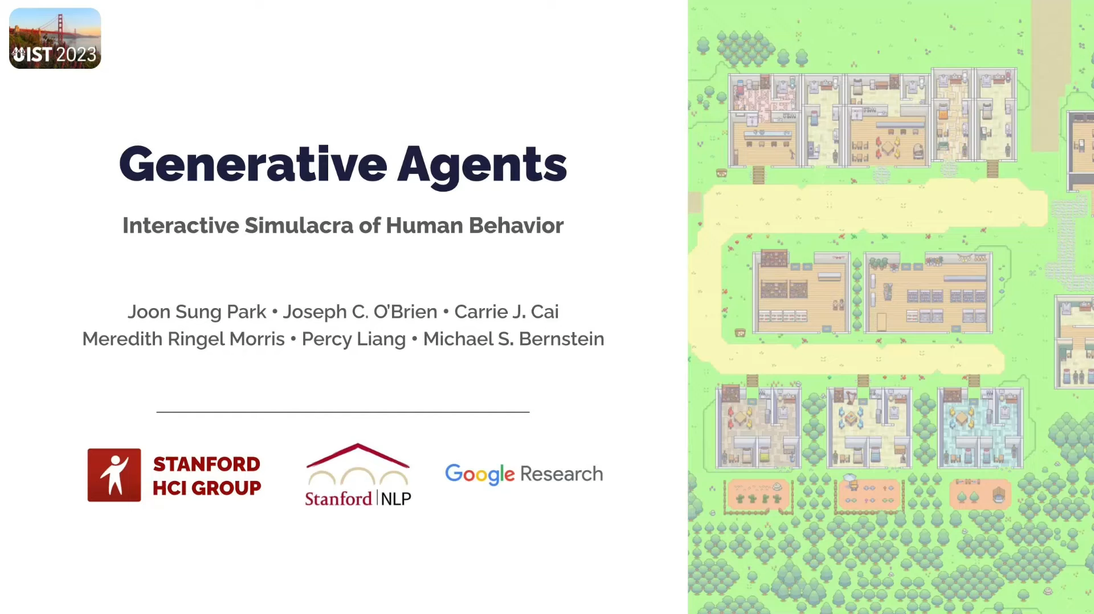
Notes:
But now, a new possibility emerges. Large Language Models not only comprehend complex problems, but also participate in simulations in human-like ways. For the first time, we can experiment with social mechanisms repeatedly and at scale in virtual environments.

Slide 29
Example: GPT Simulated Group Dialogue
Scenario: Four residents are deciding whether to move into a crowded but high-status neighborhood.
🟩 Prompt:
Simulate a group discussion between four fictional residents (Anna, Bo, Chen, and Dana) about whether to move into "Silver District," a neighborhood that is overcrowded but has better schools and public services. Each resident has a different personality:
Anna is status-driven
Bo is cost-sensitive
Chen is community-minded
Dana is skeptical and cautious
🟦 GPT Response (Excerpt):
Anna: “Silver District has the best schools in the city. We’d be crazy not to move. It’s a sign of success.”
Bo: “But have you seen the rent prices lately? We’ll be spending half our income just to say we live there.”
Chen: “I’m more concerned about the sense of community. Overcrowding might lead to disconnection.”
Dana: “I don’t trust trends. Everyone’s rushing in now, but what happens when services collapse under pressure?”
Notes:
This kind of LLM-powered dialogue helps us model social tradeoffs, value heterogeneity, and collective decision-making under pressure — all without real-world experimentation.

Slide 30
Traditional simulation vs. LLM-Enhanced Simulation
Dimension | Traditional Simulation | LLM-Enhanced Simulation
Agent Behavior Logic | Rule-based (if–then, fixed heuristics) | Language-based reasoning via LLM prompts
Behavior Complexity | Simplified, abstract | Rich, human-like, context-sensitive
Interaction Style | Predefined scripts or logic | Adaptive dialogues, emergent social dynamics
Flexibility | Low — requires reprogramming | High — behavior changes with prompt
Realism of Agents | Stylized or symbolic agents | Agents mimic beliefs, emotions, and roles
Typical Use Cases | Epidemics, traffic, spatial models | Roleplay, group decision-making, institutional simulation
Notes:
Unlike traditional agents with hard-coded logic, LLMs can simulate flexible, role-specific behavior in natural language. They learn from context, reason like humans, and respond based on evolving interaction history.

Slide 31
Social Dilemmas – What Are We Really Simulating in this Course?
If everyone made the best choice for themselves, would society become better?

Slide 32
Social Dilemma = When individual rationality leads to collective irrationality
Examples:
Tragedy of the Commons
Prisoner’s Dilemma
Free Rider Problem
Social simulation is not about predicting individual behavior, but understanding how "individual decisions" accumulate into "systemic consequences."
Notes:
LLM for social simulations is most exciting not when it replicates humans, but when it allows us to test social dilemmas at scale, safely, and transparently

Slide 33

Tragedy of the Commons:
The Tragedy of the Commons is an economic theory that describes how individuals, acting in their own self-interest, can deplete shared resources, leading to negative consequences for the entire community. (Garrett Hardin, 1968)
‘Public resources’ → ‘Individual optimum’ ≠ ‘System optimum’
Case | Individual Rationality | Collective Consequence
Environmental Pollution | Corporate Emissions | Global Warming
Fake News Spread | Liking/Sharing | Public Misinformation
Ride-hailing Competition | Fast Order Acceptance | Urban Congestion

Slide 34

Notes:
https://youtu.be/CxC161GvMPc

Slide 35
Course Logistics
Notes:
来源：https://www.tableau.com/data-insights/ai/what-is
What is Artificial Intelligence?
The original definition of AI, defined in 1955 by John McCarthy, one of the original creators of the field, was pretty broad and all-encompassing: “The science and engineering of making intelligent machines.”
A slightly more modern definition of AI is: a broad branch of computer science concerned with creating machines that can learn, make decisions, and perform tasks to a human-like level. Advanced AI machines can learn and grow on their own, independent of human intervention. Even basic AI can handle complex tasks that would normally need a human touch but may need the help of a programmer to learn from its mistakes and improve.

Slide 36
Course Overview:
Interdisciplinary & Hands-on:
Use ABM and LLM APIs to simulate complex social behaviors.
Core Case Study:
City model where agents prefer mid-density but crowd into overpopulated areas →shows tension between individual vs. collective rationality.
Key Themes:
Emergence, heterogeneity (altruism, demographics, communication), and policy effects.
Learning Format:
Lectures + Labs + 14-week team project → code, analyze, and present.
Notes:
This course offers an interdisciplinary exploration of how artificial intelligence can be applied to the social sciences. Students will gain hands-on experience with AI-assisted agent-based modeling (ABM) and large language model (LLM) APIs to simulate and analyze complex social behaviors.
The course centers on a city-model case study in which residents seek mid-density blocks but ultimately crowd into already overpopulated areas, leaving others empty. This scenario reveals tensions between individual and collective rationality, and how heterogeneity—whether in altruism vs. selfishness, demographics, or communication styles—affects outcomes. Students will also examine how city policies can either exacerbate or mitigate these dynamics.
Progressing from basic ABM implementations to theoretical analysis, in-class experiments, and LLM-driven simulations, students will investigate how micro-level decision-making leads to macro-level emergent behaviors. Emphasizing creativity, teamwork, and self-directed inquiry, the course combines lectures, coding labs, and mentorship. Over 14 weeks, teams of 4–6 will complete a supervised project, present their findings, and develop both technical skills and a deeper understanding of AI’s role in addressing real-world social challenges.

Slide 37
What is This Course, Really?
This course is NOT: A deep dive into complex math or advanced coding.
This course IS: A hands-on, practical guide to using modern AI tools (LLMs) to ask and answer big social science questions.
Key Message: "You will learn by doing. No prior experience needed."

Slide 38
How You Will Learn: Course Structure
Lecture Sessions:
Big ideas, concepts, and social science theory.
Guidance on projects and assignments.
Lab Sessions：
Hands-on, practical skill-building.
Step-by-step coding in Python & using AI APIs.
In-class work time with support.

Slide 39
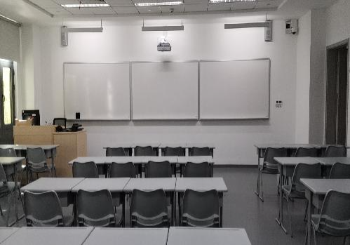
Group Discussion Room
📍 Classroom Allocation:
TD111, TD113, TD114, and TD115 (TD Building, First Floor)
classroom layouts (40 seats)
🕒 Available Hours:
Throughout AY2025-26 Term 1: Monday to Friday, 6:00 PM - 9:00 PM
📅 Important Exception:
Not available: September 5 (due to the OSA health examination event)
These classrooms are available for AIE1901 students to use for project work and group discussions during the specified hours, with the exception of the date mentioned above.

Slide 40

Self-introduction
Where you come from?
Your hobby?
Your Specialties?
Maybe personality?
Why you choose this course?
Any other things you want to share
Notes:
This course offers an interdisciplinary exploration of how artificial intelligence can be applied to the social sciences. Students will gain hands-on experience with AI-assisted agent-based modeling (ABM) and large language model (LLM) APIs to simulate and analyze complex social behaviors.
The course centers on a city-model case study in which residents seek mid-density blocks but ultimately crowd into already overpopulated areas, leaving others empty. This scenario reveals tensions between individual and collective rationality, and how heterogeneity—whether in altruism vs. selfishness, demographics, or communication styles—affects outcomes. Students will also examine how city policies can either exacerbate or mitigate these dynamics.
Progressing from basic ABM implementations to theoretical analysis, in-class experiments, and LLM-driven simulations, students will investigate how micro-level decision-making leads to macro-level emergent behaviors. Emphasizing creativity, teamwork, and self-directed inquiry, the course combines lectures, coding labs, and mentorship. Over 14 weeks, teams of 4–6 will complete a supervised project, present their findings, and develop both technical skills and a deeper understanding of AI’s role in addressing real-world social challenges.

Slide 41
Thank You!
Thank you for your attention and participation.
📬 Contact Information:
zhanzhanzhao@cuhk.edu.cn (Dr. Zhao Zhanzhan)
225080011@link.cuhk.edu.cn (Mr. Jia Xiao )

